Slide 1
Strategizing Racing Tactics for 2023 Singapore Grand Prix
A preliminary study of the Singapore weather

Slide 2
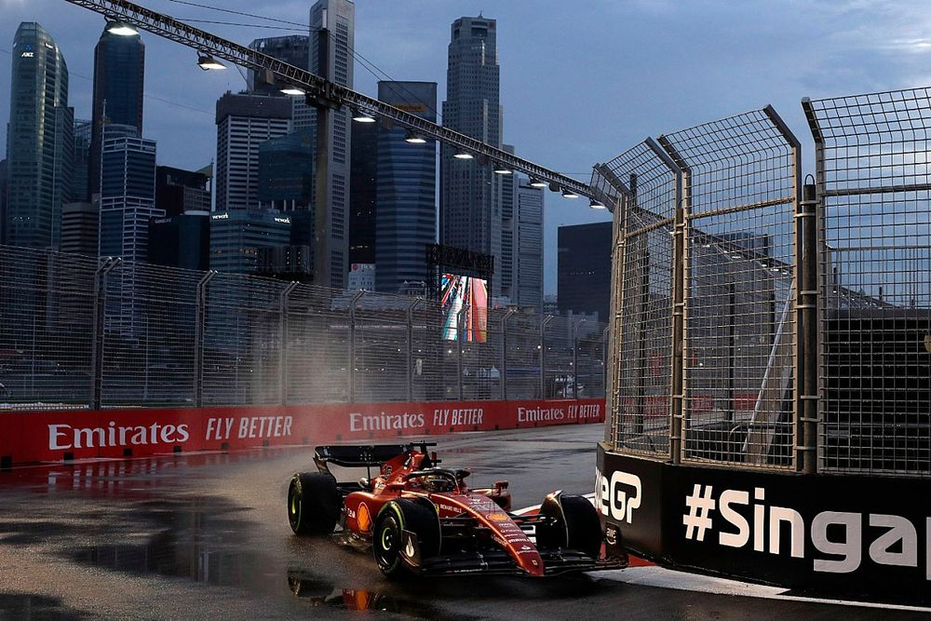
Problem Statement
The weather affects a F1 team in a multitude of ways during the strategizing process.
Temperature of the track surface significantly affects the traction of the tires. Tire selection very crucial to the outcomes of the race.
Weather plays a huge part in the tactical planning of F1 teams that would make a difference between dominating or getting dominated in the race.

Slide 3
Project Objectives
Data Visualization
Identifying trends in the data and analyse
Making recommendation based on the analysis

Slide 4
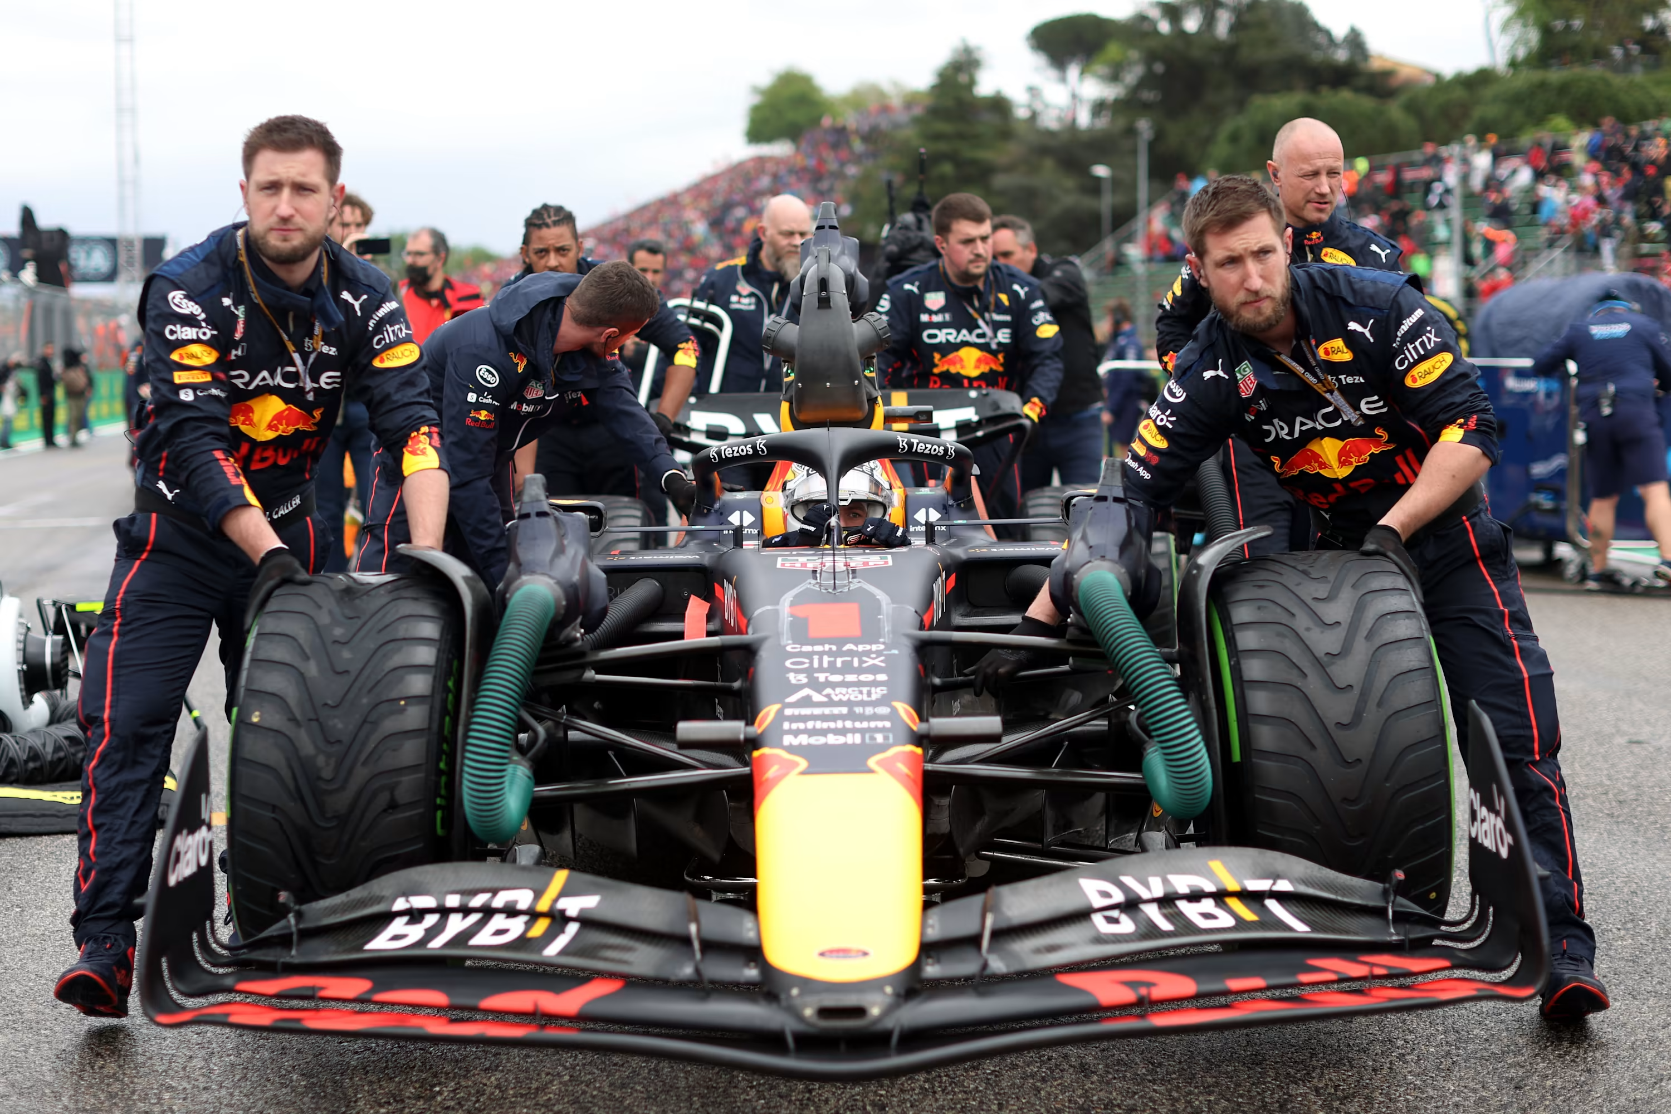
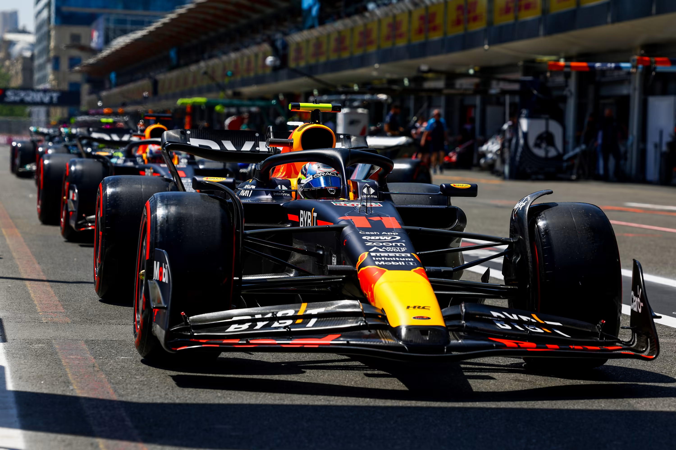
Background
Traction is plays a huge role in F1. Tire selection, management and timing is key.
3 different types of tires:
Wet
Intermediate
Slicks : Soft, Med, Hard

Slide 5
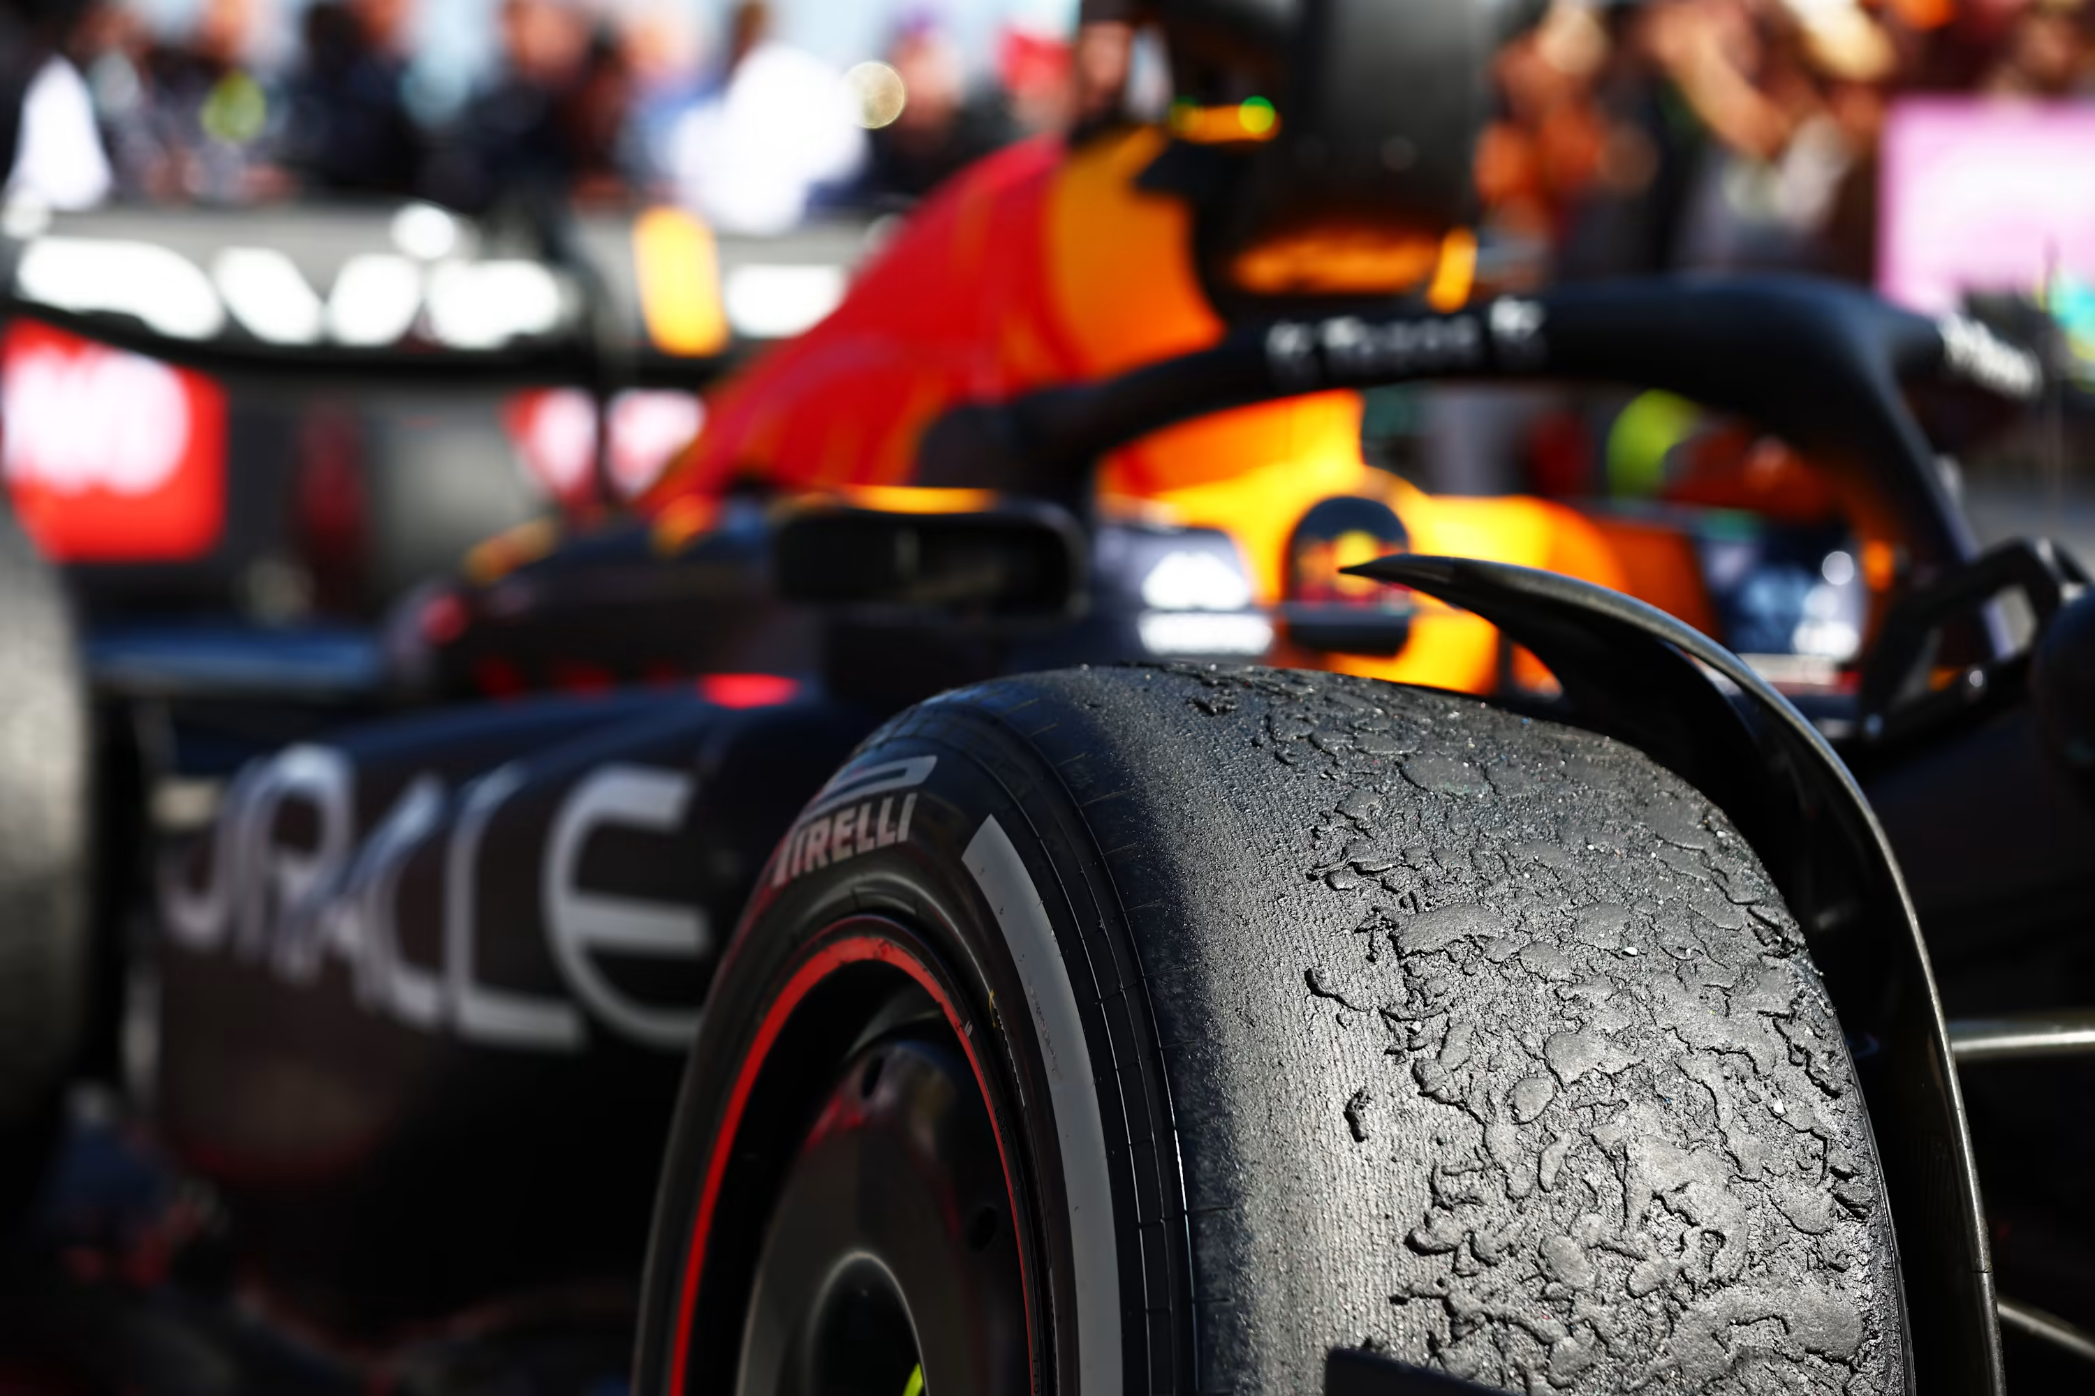
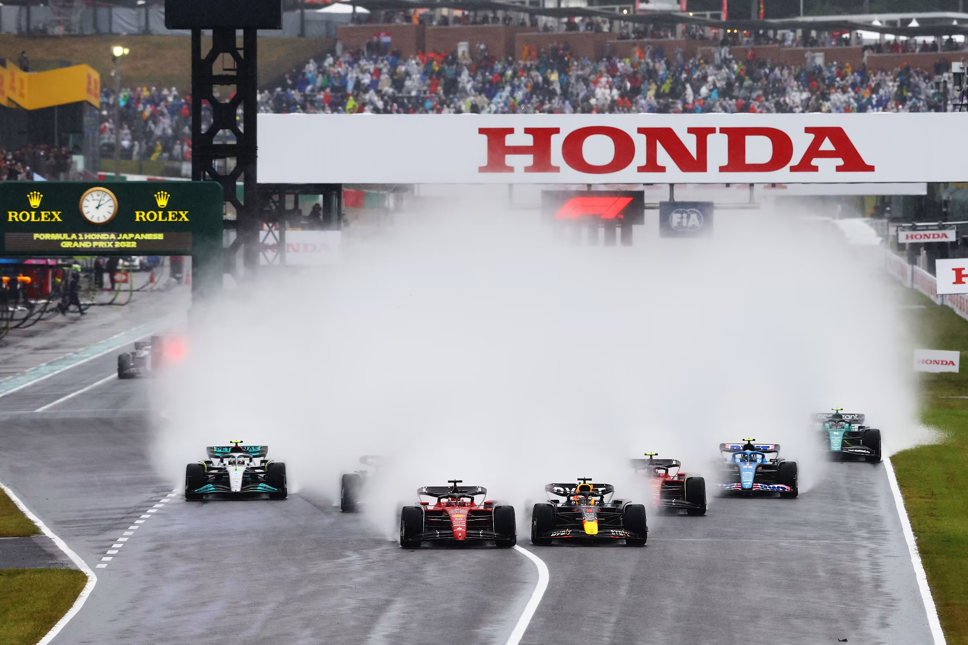
Background
If weather is hot, tires wears out easily, might not be able to push the car to its absolute limit, in fear of over heating:
If its raining, traction and visibility is significantly reduced.
Car height might need to be increase to take into account of standing water on track, reducing aerodynamics

Slide 6
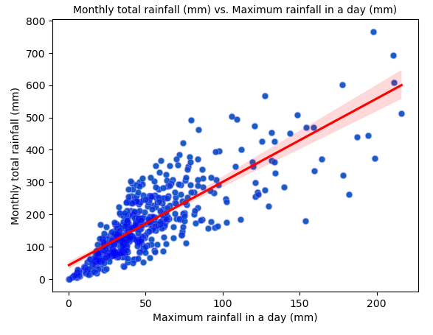
Weather Analysis: Primary Dataset
Correlations in primary dataset:
1. Monthly total rainfall vs Maximum rainfall in a day

Slide 7
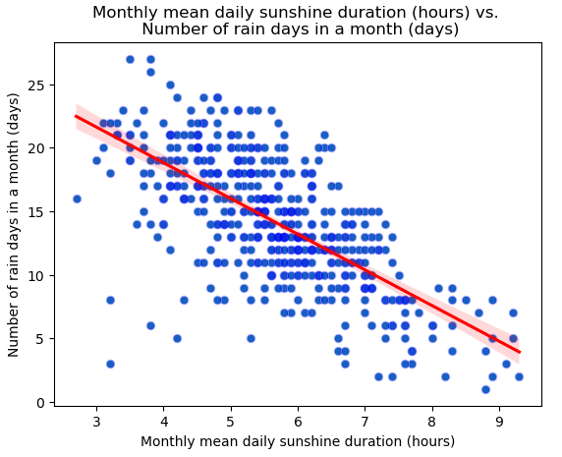
Weather Analysis : Primary Dataset
Correlations in primary dataset:
2. Monthly mean daily sunshine duration vs Number of rain days in a month

Slide 8
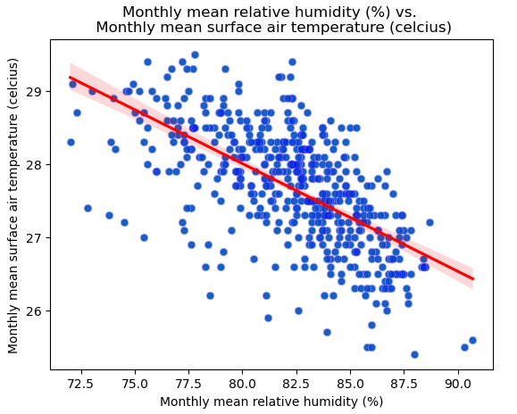
Weather Analysis : Primary Dataset
Correlations in primary dataset:
3. Monthly mean relative humidity vs Monthly mean surface air temperature

Slide 9
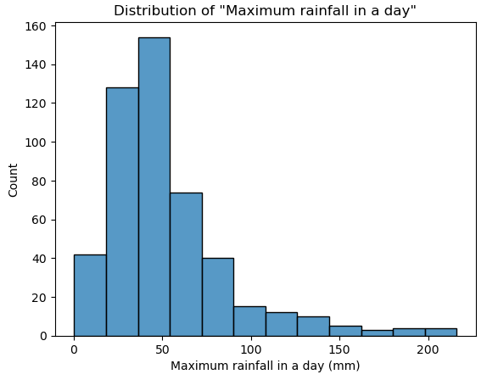
Weather Analysis : Primary Dataset
Distribution of “Maximum rainfall in a day”:
Histogram of “Maximum rainfall in a day”

Slide 10
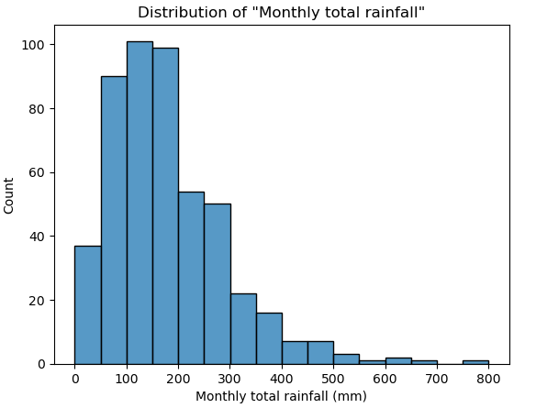
Weather Analysis : Primary Dataset
Distribution of “Monthly total rainfall”:
Histogram of “Monthly total rainfall”

Slide 11
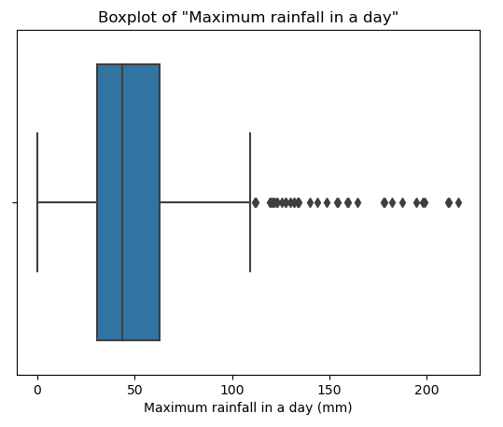
Weather Analysis : Primary Dataset
Outliers check for “Maximum rainfall in a day”:
Boxplot of “Maximum rainfall in a day”

Slide 12
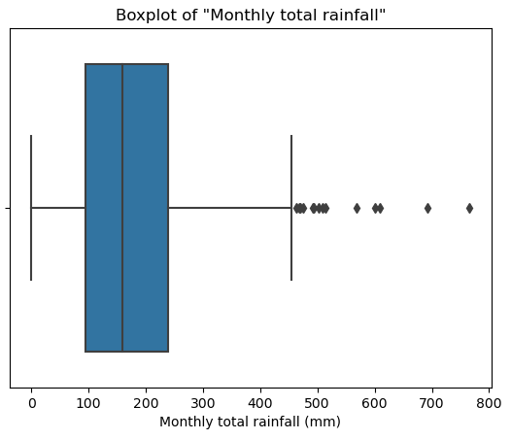
Weather Analysis : Primary Dataset
Outliers check for “Monthly total rainfall”:
Boxplot of “Monthly total rainfall”

Slide 13
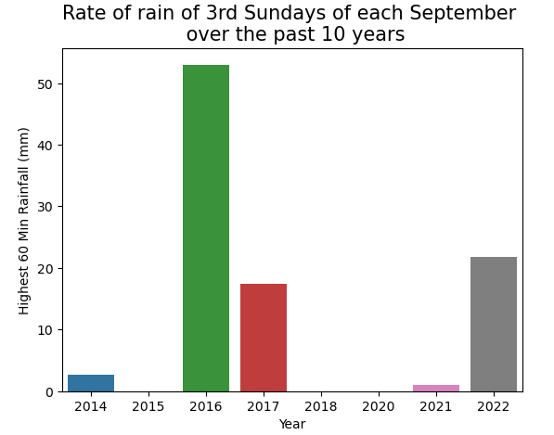
Weather Analysis : Secondary Dataset
Rate of rain:
Bar chart of “Highest 60min Rainfall” over the past 10 years

Slide 14
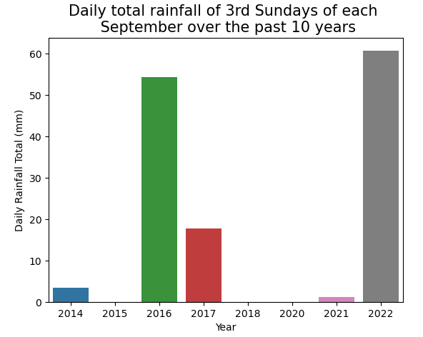
Weather Analysis : Secondary Dataset
Daily total rainfall:
Bar chart of “Daily Rainfall Total” over the past 10 years

Slide 15
Conclusion and Recommendation
There were a lot of outliers from the primary dataset, indicating extreme weather changes.
Recommended for F1 team to prepare for a intermediate / wet condition racing for the 2023 Singapore Grand Prix, with a high possibility of the race being delayed in the mid of the Grand Prix due to rain.
The secondary data indicated rainfall that somewhat coincided with El Nino Southern Oscillation (ENSO) records over the years.

Slide 16
Key Limitations
Secondary data was only obtained up till 2010, with numerous missing entries in the early years
Due to time constraint, was not able to study into the El Nino Southern Oscillation (ENSO) year records to determine if there are more correlation that would help us to potentially predict the weather for the 2023 Singapore Grand Prix with a higher degree of certainty.
Current analysis and recommendations are made under the assumption that the future will repeat similar trends from the past.

